Slide 1
LINKED LISTS

Slide 2
Linked Lists
Dynamic Data structures made up of nodes
Data is not stored in contiguous memory Locations
Insertion and deletion of elements is easier
Can be used to implement abstract data types like Stacks and Queues
Efficient random access is not possible
Implementation requires extra memory

Slide 3
Types of Linked Lists
Single Linked Lists
Double Linked Lists
Circular Linked Lists

Slide 4
List ADT
void add(Type newItem)
Add items to the end of the list
void add(int position, Type newItem)
Add item at a certain position
boolean contains(Type item)
Check if an Item exists in the list
int size()
Return length of the list
boolean isEmpty()
Delete the list
Type get(int position)
Get node at a particular position
Type delete(int position)
Delete a node at a particular position
void printList()

Slide 5
Single Linked List
node
A
data
next
A
B
C
∅
Head

Slide 6
Nodes : objects to store elements
A special "node" type of object that represents an element of a list
Each node will keep a reference to the node after it (the "next" node)
The last node will have next == null, signifying the end of the list

Slide 7
Linked List Implementation
Linked List: a list implemented using a linked sequence of nodes
The list only needs to keep a reference to the first node (we might name it head)
In Java: java.util.LinkedList (but we'll write our own)

Slide 8
Finding References
Finding references to the following node:
Last Node
Second to last node
Node with specific data;
Predecessor to node with specific data
Node at a specific position

Slide 9
Insertion in Linked List
Insert at the beginning of the list
O(1)
Insert at the end of the List
O(n)
Insert at a given position
O(n)

Slide 10
Deletion in Linked List
Delete at the beginning of the list
O(1)
Delete at the end of the List
O(n)
Delete at a given position
O(n)

Slide 11
Linked List Implementation of Stack & Queue
STACKS
Only the position of the head changes for both push and pop operations
push() – Always Insert at the beginning
O(1)
pop() - Always Delete at the beginning
O(1)
QUEUES with Singly Linked List
Position of the Last Node and the head are changed
enqueue() – Always Insert at the beginning
O(1)
dequeue() – Always delete from the end
O(n) – for n elements in the singly linked list.

Slide 12
Reversing a Linked List
Node prev, curr, next;
prev = null;
curr = head;
while(curr!=null)
{
next = curr.nextNode;
curr.nextNode = prev;
prev = curr;
curr = next;
}
head = prev;
A
B
C
∅
Head
A
∅
B
C
Head

Slide 13
Sorting a Linked List – Swap Data
node end, p ,q;
for(end=null; end!=start.nextNode; end=p)
{
for(p=head;p.nextNode!=end;p=p.nextNode)
{
q=p.nextNode;
if(p.data > q.data)
{
int temp=p.data;
p.data=q.data;
q.data=temp;
}
}
}

Slide 14
Circular Linked Lists
A circular, singly linked list is like a singly linked list, except that the pointer of the last node points back to the first node.
If curr.nextNode = = head , you have reached the last node in the list.

Slide 15
Circular Linked Lists
Advantages
Disadvantages
Entire Linked List can be traversed starting at any node.
Fewer special cases for insertion and deletion, since all nodes have a previous node and a next node.
Insertion at the start of the list requires, traversing the entire list to find the last node of the list.
Finding the end of list and the loop control requires an extra reference variable.

Slide 16
Doubly Linked Lists

Slide 17
Doubly Linked Lists
A doubly linked list contains the nodes with two references.
One refers to the nextNode and the other points to the prevNode.
A doubly linked list can be traversed forward and backward.

Slide 18
Doubly Linked Lists
Advantages
Disadvantages
Can be traversed in both forward and backward directions
Implementation of some operations is easier, insertion and deletion can be done with a single reference
Extra space is required for storing previous node link.
While inserting and deleting , extra steps are required to maintain the previous node link

Slide 19
Doubly Linked List - Node
public class Node
{
public Node prevNode;
public int data;
public Node nextNode;
public Node(int i)
{
data = i;
prevNode = null;
nextNode = null;
}
}

Slide 20
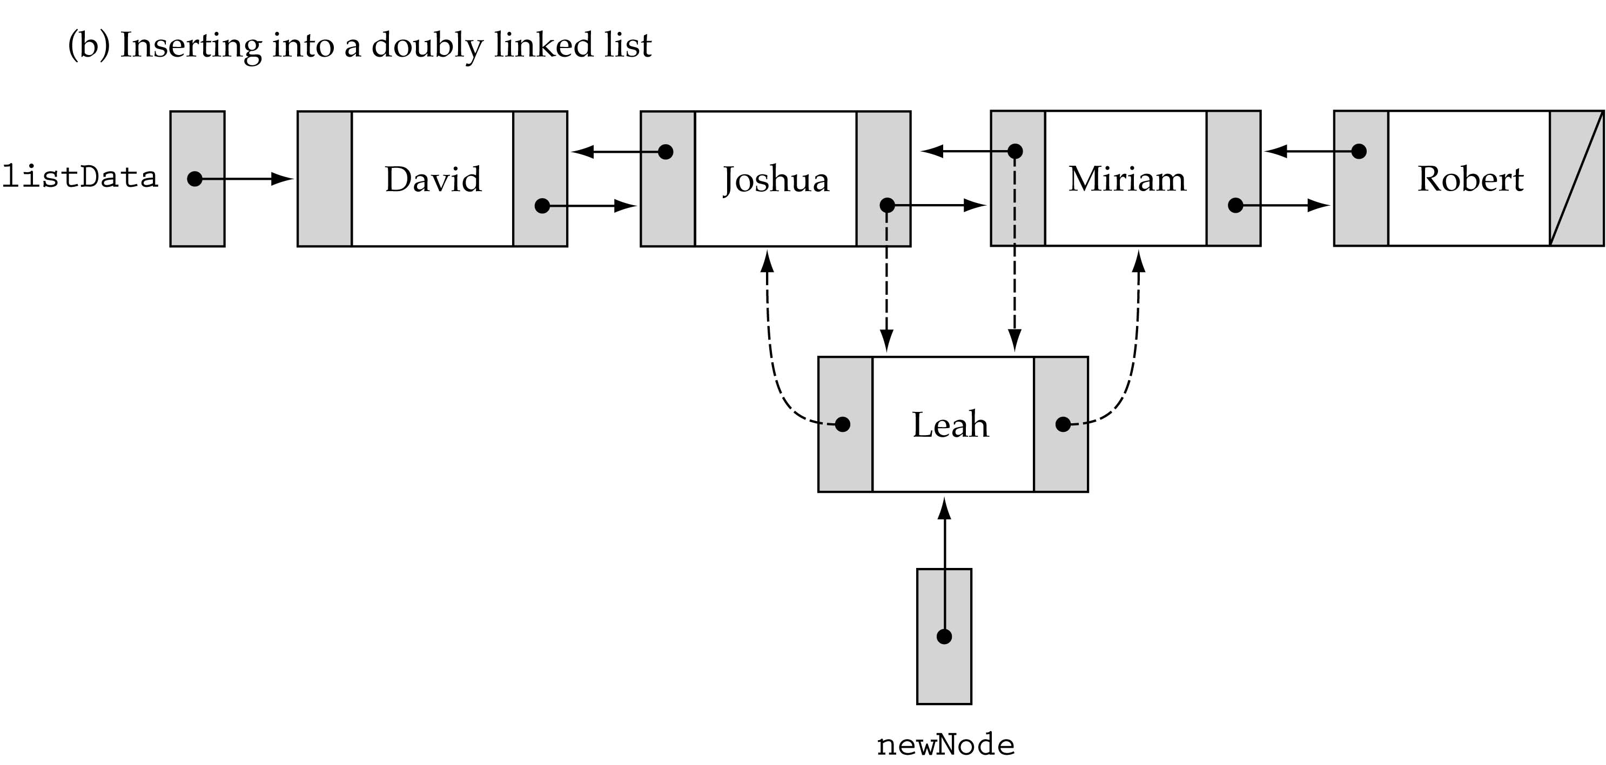
Insertion in a Doubly linked List

Slide 21
Inserting in a Doubly Linked List
Inserting first node:
Create a new node temp
head = temp;
head
∅
A
∅

Slide 22
Inserting in a Doubly Linked List
Inserting in the beginning of the List:
Create a new node temp
temp.nextNode = head;
head.prevNode = temp;
head = temp
head
B
C
∅
∅
A
∅

Slide 23
Inserting in a Doubly Linked List
Inserting in the end of the List:
Create a new node temp - > Locate last node of the list lastNode
lastNode.nextNode = temp;
temp.prevNode = lastNode;
last
head
B
∅
∅
A
∅
C
∅

Slide 24
Inserting in a Doubly Linked List
Inserting after some Node p:
Create a new node temp - > Locate Node p
temp.prevNode = p;
temp.nextNode = p.nextNode;
p.nextNode.prevNode = temp;
p.nextNode = temp;
p
head
B
C
∅
∅
A
∅
X
∅

Slide 25
Inserting in a Doubly Linked List
Inserting before some Node p:
Create a new node temp
Locate Node p
temp.prevNode = p.prevNode;
temp.nextNode = p;
p.prevNode.nextNode = temp;
p.prevNode = temp;

Slide 26
Deleting in a Doubly Linked List
Deleting Only node:
Create a new node temp
head = null;
head
∅
∅
∅
A

Slide 27
Deleting in a Doubly Linked List
Deleting from the beginning of the List:
head = head.nextNode;
head.prevNode = null;
head
∅
A
∅
B
C
∅

Slide 28
Deleting in a Doubly Linked List
Deleting from the end of the List:
Locate lastNode
lastNode.prevNode.nextNode = null;
last
head
∅
A
B
∅
C
∅

Slide 29
Deleting in a Doubly Linked List
Deleting some Node p:
Locate Node p
p.prevNode.nextNode = p.nextNode;
p.nextNode.prevNode = p.prevNode;
p
head
∅
A
B
C
∅

Slide 30
Reversing a Doubly Linked List
head
∅
A
B
∅
C
∅
head
∅
C
B
∅
A
∅

Slide 31
Reversing a Doubly Linked List
Node p1 = head;
Node p2 = p1.nextNode;
p1.nextNode = null;
p1.prevNode = p2;
while(p2!=null)
{
p2.prevNode = p2.nextNode;
p2.nextNode = p1;
p1 = p2;
p2 = p2.prevNode;
}
head = p1;

Slide 32
Concatenation – Singly Linked Lists
Joining One linked List to the end of another linked list.
last
A
B
C
∅
p=head;
while(p.nextNode!=null)
p=p.nextNode;
p.nextNode = head2;
Head
D
E
F
∅
Head 2

Slide 33
Concatenation – Circular Linked Lists
head=last.nextNode;
last.nextNode = last2.nextNode
last2.nextNode = head;
last = last2;
head
last
A
B
C
last
last2
D
E
F

